Slide 1






FACE SIMILARITY FINDER
ISO 9001:2015 Cert. No. 0055706
ISO 27001:2013 Cert. No. 010094
Project Initiated : Dec -02
No of members : 3
Team members : Robin Cruz T P
Sri Krishna M
Madhumitha K

Slide 2

USE CASE
GIVEN TWO IMAGES :
1. PERSON IMAGE
2. DOCUMENT
IDENTIFY IF BOTH IMAGES CONTAIN THE SAME PERSON'S FACE OR NOT.
ACCORDING TO THE REQUEST, GENDER OF THE FACES IDENTIFIED FROM THE INPUTS
SHOULD BE CLASSIFIED INTO MALE OR FEMALE.
1 FOR DOCUMENT GENDER
2 FOR PERSON IMAGE GENDER
3 FOR BOTH
4 FOR NONE

Slide 3



WORK FLOW VISUAL ENCODING

Slide 4
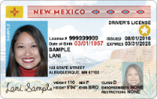
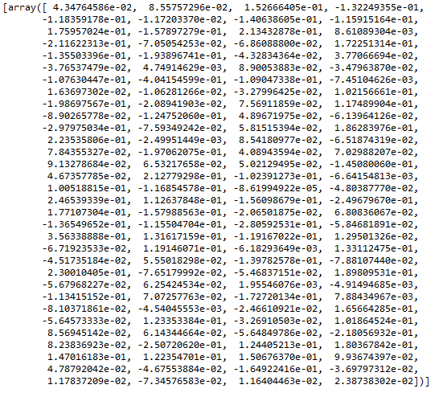

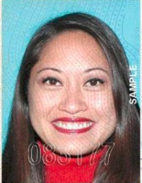
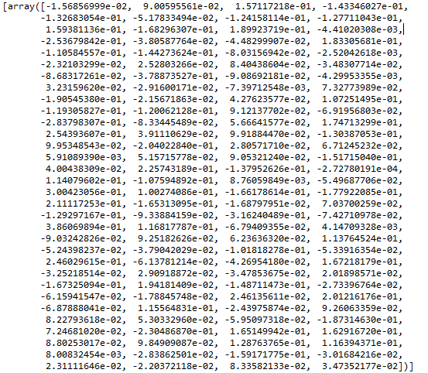
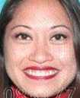
WORKFLOW - ACTUAL
EDA
Similarity

Slide 5
WORKING - FACE SIMILARITY FINDER
EXTRACTION OF FACE
GIVEN IMAGES ARE SCANNED FOR FACES AND COORDINATES OF THEM ARE RECEIVED,
WITH THE COORDINATES THE ROI(REGION OF INTEREST) IS OBTAINED AND GIVEN IMAGE IS CROPPED TO GET THE FACES.
ENCODING THE FACES
THE FACES OBTAINED ARE CONVERTED TO ARRAYS USING NUMPY AND IS ENCODED INTO
128-ENCODING VALUES USING HOG.
DEVIATION IN ENCODINGS
THE ENCODINGS OF FACES ARE CALCULATED FOR THEIR DEVIATION USING EUCLIDEAN DISTANCE ALGORITHM.

Slide 6
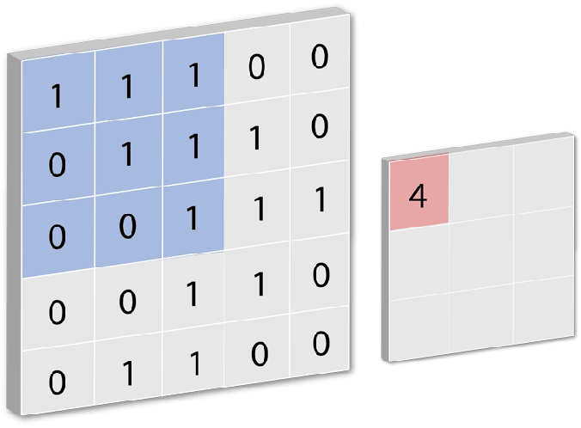
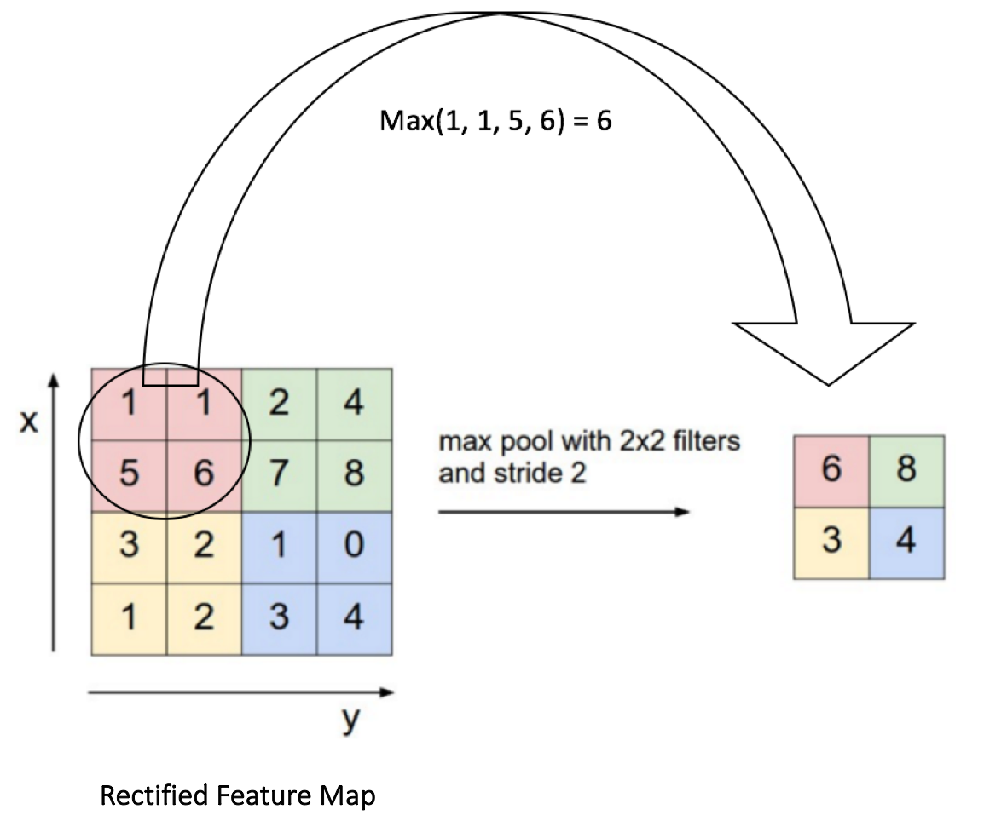
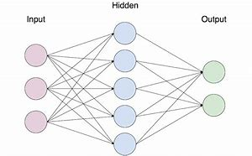
WORKING GENDER CLASSIFICATION
6
8
3
4

Slide 7
WORKING - GENDER CLASSIFICATION
PRE-PROCESSING
THE OUTPUT OF OPENCV IMAGE IS,
RESIZED INTO DEFAULT 96 X 96,
SCALED WITH DEFAULT 255 SCALE FACTOR
CONVERTED TO A NUMPY ARRAY
3-DIMENSIONAL LIST IS CONVERTED TO 4-DIMENSIONAL LIST
CLASSIFICATION
THE PRE-PROCESSED INPUT IS,
CONVOLUTED
POOLED
FLATTENED
NOW THE FLATTENED IMAGE FORMAT IS CLASSIFIED USING PRE-TRAINED KERAS MODEL.

Slide 8
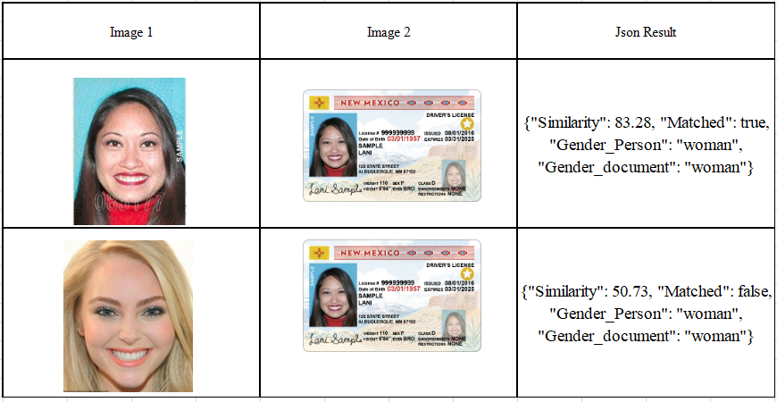
SAMPLE I/P AND O/P

Slide 9
REQUIREMENTS
PACKAGES :
1.OpenCV 7.Face_recognition
2.Tensorflow 8.JSON
3.Keras 9.Re
4.Numpy 10.Os
5.Cmake 11.Sys
6.Dlib
INPUT :
1.Image can be either in JPG or PNG format
2.Image dimensions must be above 96 x 96
MODEL:
Pre-trained model (Gender_Classification)

Slide 10
REFERENCES
FACIAL_RECOGNITION DOCUMENTATION
DLIB DOCUMENTATION
CAT AND DOG CLASSIFIER
HOG ENCODING

Slide 11

THANK YOU
SYSVEDA INFORMATION TECHNOLOGY PVT LTD
126, Estate Main Road,
Perungudi Industrial Estate,
Perungudi, Chennai - 600 096, India.
Tel: +91 44 6609 1100 Fax: +91 44 6609 1111
SYSVEDA INFORMATION TECHNOLOGY
Daiko Bldg, 7F, 3-10-10,
Kanda Jimbocho, Chiyoda-ku
Tokyo 101-0051, Japan.
Tel: +81 3 3511 2055 Fax: +81 3 3511 2056
SYSVEDA AMERICA INC
80 Broad Street, 5th Floor,
New York. NY 10004.
USA.
Tel: +1 917 751 7978 Fax: +1 212 208 4501
SYSVEDA UK LIMITED
Imperial House, 2, Heigham Road,
London,
United Kingdom.
Tel: +44 208 552 1508

